Slide 1
Module 6 – Data Operations Day 4
Presented by
Group A: Jonathan C., Michael, Craig, Jo

Slide 2
Introduction
Plan, build and present an ETL Pipeline, end to end.
Sprint 1 = Planning
Sprint 2 = Execution/BUILD
Sprint 3 = Presentation/Demo

Slide 3
Sprint 1 - PLANNING
Reviewed the scripts
Reviewed the skill base of the Team
Agree on tasks and roles
MSCW
Must Have: meaningful logs, visibility
Must Have: response to failures/alerting
Must Have: Quality and Governance
Must Have: persisted database/reusable code
Should Have: pull data from API/sources (no hard-coded logic where a data source exists)
Should Have: Power BI Dashboard
Could Have: GitHub repo
Could Have: Kanban Board
Notes:
Example objectives
At the end of this lesson, you will be able to:
Save files to the team Web server.
Move files to different locations on the team Web server.
Share files on the team Web server.

Slide 4
User Stories – Sprint 1
As a Data Engineer, I want to design a monitoring dashboard so that stakeholders can see pipeline health at a glance.
As a Data Engineer, I want to visualise our ETL data flow so that team members understand the pipeline structure.
As a Data Engineer, I want to assess what's missing for production deployment so that we can prioritise improvements.
As a Data Steward, I want to create a change log for all improvements so we can track what's been changed in the pipeline.
As a Developer, I want to parameterise the data source and output file so that others can reuse it.
As a Data Engineer, I want structured logging in our ETL pipeline so that I can track execution progress and identify issues.
As a Data Engineer, I want to monitor database connectivity so that I can detect connection issues before they cause pipeline failures.
As a Data Operations Manager, I want a comprehensive monitoring strategy so that our team can effectively observe pipeline health.
As a Data Engineering Team Lead, I want to understand current monitoring gaps so that I can prioritise observability improvements.
As a Data Engineer, I want a clear incident response process so that I can quickly resolve pipeline failures.
Technology Decision = Azure/Fabric Monitoring
As a Data Operations Manager, I want a comprehensive logging strategy so that our team can effectively troubleshoot pipeline issues.
As a Data Engineer, I want detailed pipeline performance metrics so that I can optimise processing time and resource usage.
As a Data Operations Team, I want email notifications for critical pipeline failures so that we can respond quickly to issues.

Slide 5
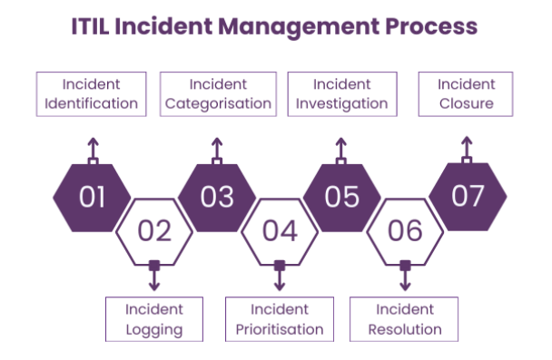
Monitoring Strategy and Incident Response
As a Data Operations Manager, I want a comprehensive monitoring strategy so that our team can effectively observe pipeline health.
As a Data Operations Manager, I want a comprehensive logging strategy so that our team can effectively troubleshoot pipeline issues.
As a Data Engineering Team Lead, I want to understand current monitoring gaps so that I can prioritise observability improvements.
As a Data Operations Team, I want email notifications for critical pipeline failures so that we can respond quickly to issues.
As a Data Engineer, I want structured logging in our ETL pipeline so that I can track execution progress and identify issues.
As a Data Engineer, I want to monitor database connectivity so that I can detect connection issues before they cause pipeline failures.
As a Data Engineer, I want a clear incident response process so that I can quickly resolve pipeline failures.
Power BI Dashboard and on-screen alerting in Data Ops
Incident Strategy – agree P1, P2 response times with Data Engineering Team as a resolving team.
Email Alerting to central Data Operations inbox/Teams Channel.
Comms Strategy – agree comms templates to Stakeholders when there are outages, both Planned and Unplanned.
Root Cause Analysis and Problem strategy

Slide 6
KANBAN BOARD
To Do​ | In Progress​ | Done​
Run Jupyter Notebook | Agree MOSCOW | Task 7​
Review build/improvements | Data Flow Diagram | Task 8​
Agree Technology/code |  | Task 9​
Identify API/sources
Agree Dashboard content
Agree Monitoring Strategy/Incident Response

Slide 7
Sprint 2 - EXECUTION
BUILD PIPELINE
Testing
Power BI Dashboard
Notes:
Example objectives
At the end of this lesson, you will be able to:
Save files to the team Web server.
Move files to different locations on the team Web server.
Share files on the team Web server.

Slide 8
Sprint 3 - DEMO
Notes:
Example objectives
At the end of this lesson, you will be able to:
Save files to the team Web server.
Move files to different locations on the team Web server.
Share files on the team Web server.

Slide 9
Wrap-up
Summarise important points.
Allow time for questions.

